Slide 1
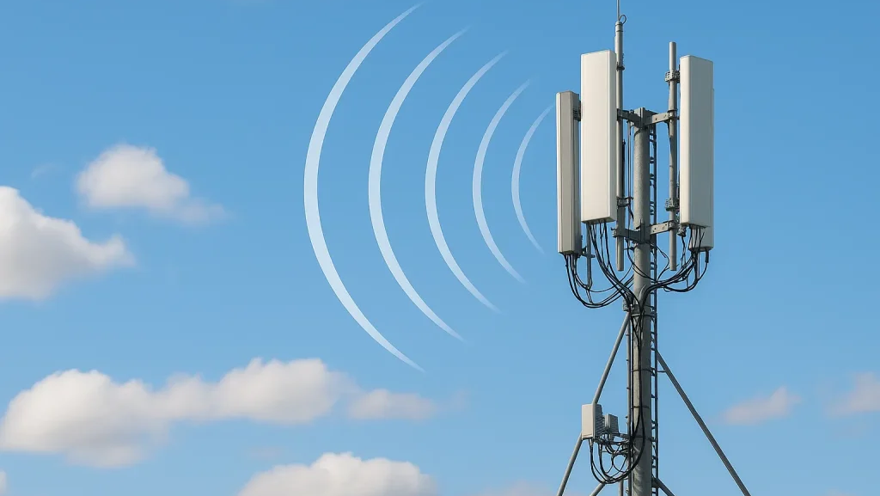
Part- II
Introduction to Wireless Cellular Networks
From Analog Voice to Intelligent 5G Networks
1G
2G
3G
4G
5G
Part II
Notes:
Welcome to this presentation on the Evolution of Cellular Networks. In this introductory session, we will explore why cellular communication was invented, what problems it solves, and what driving forces have shaped its evolution from the first generation to the intelligent 5G networks we see today. Before cellular networks, communication was entirely tethered. People used wired telephones that required a physical connection to a landline. This meant you could only make or receive calls from specific locations, typically your home or office. The concept of mobility in communication was virtually nonexistent. The fundamental breakthrough of cellular technology was the idea of dividing geographic areas into "cells," each served by a base station or cell tower. This cellular concept, first proposed by Bell Labs engineers in the 1940s and implemented in the 1980s, allowed frequency reuse and made large-scale mobile telephony economically viable. As we trace the timeline from 1G in the 1980s through to 5G today, notice that each generation was not merely a speed upgrade. Each generation responded to fundamentally new demands: 1G solved basic mobile voice, 2G added digital clarity and texting, 3G brought the internet to our pockets, 4G enabled mobile broadband and streaming, and 5G is designed for an entirely new era of intelligent connected devices, from autonomous vehicles to smart cities. By the end of Part I, you should understand the key motivations behind cellular network evolution and appreciate how user demands and technological capabilities have always advanced together.

Slide 2
Contents
Second Generation (2G) Cellular Networks
GSM Core Network (Network Switching Subsystem)
2.5G – General Packet Radio Service (GPRS)
2.75G – EDGE (Enhanced Data Rates for GSM Evolution)
3GPP Standardization
3G Enhancements
More Users
Beer Spectrum
Higher Capacity
Higher Speed
Better Experience
Part II
Notes:
This final slide of Part I summarizes the core objectives that have guided the evolution of cellular networks across all generations. Understanding these objectives helps us appreciate why each design decision was made and what the industry aims to achieve with ongoing research into 5G-Advanced and 6G. Let's examine the ten key parameters that cellular engineers continuously optimize: **Coverage:** From 1G to 5G, the goal has always been to extend network reach. Early cellular networks covered only major cities. Today, we expect coverage everywhere—rural areas, highways, underground trains, and even remote oceans via satellite integration. Each generation improves propagation characteristics and builds more cell towers. **Capacity:** As more users join and each user consumes more data, networks must handle higher traffic density. Techniques like cell splitting (dividing large cells into smaller ones), spectrum expansion, and advanced modulation have multiplied network capacity by millions of times since 1G. **Data Rate:** Perhaps the most visible metric—each generation delivers dramatically faster speeds. 1G's 2.4 kbps versus 5G's 20 Gbps represents an approximately 8-million-fold increase. This enables richer applications from text to video to immersive experiences. **Latency:** While early networks had latency of hundreds of milliseconds, 5G aims for under 1 millisecond. Low latency is critical for real-time applications like online gaming, virtual reality, remote surgery, and autonomous vehicle coordination where delays can be dangerous. **Reliability:** 5G targets 99.9999% reliability (six nines) for mission-critical applications. This means the network can fail for only about 30 seconds per year. Achieving this requires redundant infrastructure, intelligent routing, and self-healing network capabilities. **Security:** Each generation has introduced stronger encryption and authentication. 5G implements advanced security features including stronger encryption algorithms, subscriber privacy protection, and network slicing isolation to prevent cross-tenant attacks. **Energy Efficiency:** With billions of devices and millions of base stations, energy consumption matters both environmentally and economically. 5G is designed to use significantly less energy per bit transmitted, and supports features that allow IoT devices to operate for years on a single battery. **Quality of Service (QoS):** Modern networks must prioritize different traffic types appropriately—emergency calls get highest priority, video calls need consistent bandwidth, and IoT sensors can tolerate delays. Network slicing in 5G creates virtual networks optimized for specific services. **Mobility:** Supporting users moving at high speeds—from walking to cars to high-speed trains—is a fundamental cellular challenge. Each generation improves handover mechanisms that seamlessly transfer connections between base stations. **Spectral Efficiency:** Spectrum is limited and expensive. Each generation packs more bits per Hertz of spectrum through advanced techniques like MIMO (Multiple Input Multiple Output), beamforming, and higher-order modulation. The conceptual diagram shows the virtuous cycle: more users demand better spectrum usage, which enables higher capacity, which delivers higher speed, which creates better user experience—driving demand even further.

Slide 3
Second Generation (2G) Cellular Networks
The Second Generation (2G) of cellular networks marked the transition from analog to digital mobile communication. Introduced in the early 1990s, 2G significantly improved voice quality, increased network capacity, enhanced security, and introduced new services such as Short Message Service (SMS). The Subscriber Identity Module (SIM) stored the subscriber's identity (IMSI) and cryptographic authentication key was also introduced during this period.
Key Features of 2GDigital cellular communication
Improved voice quality
Better spectral efficiency
Enhanced security through encryption
Support for SMS (Short Message Service)
Improved battery life
Higher network capacity
International roaming support through GSM
Region | Standard
Europe | GSM (Global System for Mobile Communications)
North America | IS-54 (D-AMPS), IS-95 (cdmaOne)
Japan | PDC (Personal Digital Cellular)
More Users
Beer Spectrum
Higher Capacity
Higher Speed
Better Experience
The most successful and widely adopted 2G technology was GSM, which became the global standard for digital mobile communications.
Part II
Notes:
This final slide of Part I summarizes the core objectives that have guided the evolution of cellular networks across all generations. Understanding these objectives helps us appreciate why each design decision was made and what the industry aims to achieve with ongoing research into 5G-Advanced and 6G. Let's examine the ten key parameters that cellular engineers continuously optimize: **Coverage:** From 1G to 5G, the goal has always been to extend network reach. Early cellular networks covered only major cities. Today, we expect coverage everywhere—rural areas, highways, underground trains, and even remote oceans via satellite integration. Each generation improves propagation characteristics and builds more cell towers. **Capacity:** As more users join and each user consumes more data, networks must handle higher traffic density. Techniques like cell splitting (dividing large cells into smaller ones), spectrum expansion, and advanced modulation have multiplied network capacity by millions of times since 1G. **Data Rate:** Perhaps the most visible metric—each generation delivers dramatically faster speeds. 1G's 2.4 kbps versus 5G's 20 Gbps represents an approximately 8-million-fold increase. This enables richer applications from text to video to immersive experiences. **Latency:** While early networks had latency of hundreds of milliseconds, 5G aims for under 1 millisecond. Low latency is critical for real-time applications like online gaming, virtual reality, remote surgery, and autonomous vehicle coordination where delays can be dangerous. **Reliability:** 5G targets 99.9999% reliability (six nines) for mission-critical applications. This means the network can fail for only about 30 seconds per year. Achieving this requires redundant infrastructure, intelligent routing, and self-healing network capabilities. **Security:** Each generation has introduced stronger encryption and authentication. 5G implements advanced security features including stronger encryption algorithms, subscriber privacy protection, and network slicing isolation to prevent cross-tenant attacks. **Energy Efficiency:** With billions of devices and millions of base stations, energy consumption matters both environmentally and economically. 5G is designed to use significantly less energy per bit transmitted, and supports features that allow IoT devices to operate for years on a single battery. **Quality of Service (QoS):** Modern networks must prioritize different traffic types appropriately—emergency calls get highest priority, video calls need consistent bandwidth, and IoT sensors can tolerate delays. Network slicing in 5G creates virtual networks optimized for specific services. **Mobility:** Supporting users moving at high speeds—from walking to cars to high-speed trains—is a fundamental cellular challenge. Each generation improves handover mechanisms that seamlessly transfer connections between base stations. **Spectral Efficiency:** Spectrum is limited and expensive. Each generation packs more bits per Hertz of spectrum through advanced techniques like MIMO (Multiple Input Multiple Output), beamforming, and higher-order modulation. The conceptual diagram shows the virtuous cycle: more users demand better spectrum usage, which enables higher capacity, which delivers higher speed, which creates better user experience—driving demand even further.

Slide 4
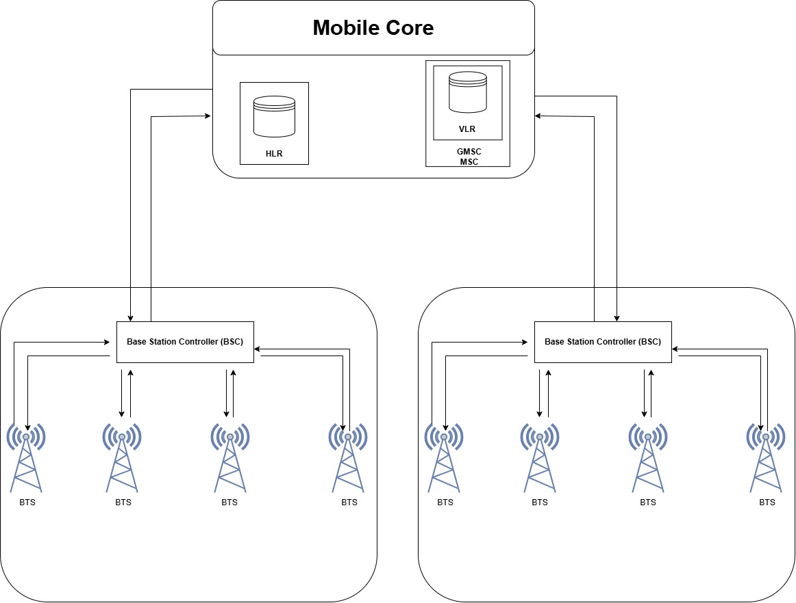
Second Generation (2G) Cellular Networks
GSM Radio Access Network (RAN)
The Radio Access Network (RAN) provides the wireless interface between the Mobile Station (MS) and the Core Network. It enables users to access cellular services through radio communication.
Components of GSM RAN
Base Transceiver Station (BTS)
Base Station Controller (BSC)
The Base Transceiver Station (BTS) is responsible for transmitting and receiving radio signals. Multiple BTSs are managed by a Base Station Controller (BSC), which supervises their operation by allocating radio channels, managing radio resources, and coordinating handovers as users move between neighboring cells. In addition, the BSC aggregates traffic from multiple BTSs and forwards it to the Core Network for further processing and service deliver
Beer Spectrum
Higher Capacity
Higher Speed
Better Experience
Part II
Notes:
This final slide of Part I summarizes the core objectives that have guided the evolution of cellular networks across all generations. Understanding these objectives helps us appreciate why each design decision was made and what the industry aims to achieve with ongoing research into 5G-Advanced and 6G. Let's examine the ten key parameters that cellular engineers continuously optimize: **Coverage:** From 1G to 5G, the goal has always been to extend network reach. Early cellular networks covered only major cities. Today, we expect coverage everywhere—rural areas, highways, underground trains, and even remote oceans via satellite integration. Each generation improves propagation characteristics and builds more cell towers. **Capacity:** As more users join and each user consumes more data, networks must handle higher traffic density. Techniques like cell splitting (dividing large cells into smaller ones), spectrum expansion, and advanced modulation have multiplied network capacity by millions of times since 1G. **Data Rate:** Perhaps the most visible metric—each generation delivers dramatically faster speeds. 1G's 2.4 kbps versus 5G's 20 Gbps represents an approximately 8-million-fold increase. This enables richer applications from text to video to immersive experiences. **Latency:** While early networks had latency of hundreds of milliseconds, 5G aims for under 1 millisecond. Low latency is critical for real-time applications like online gaming, virtual reality, remote surgery, and autonomous vehicle coordination where delays can be dangerous. **Reliability:** 5G targets 99.9999% reliability (six nines) for mission-critical applications. This means the network can fail for only about 30 seconds per year. Achieving this requires redundant infrastructure, intelligent routing, and self-healing network capabilities. **Security:** Each generation has introduced stronger encryption and authentication. 5G implements advanced security features including stronger encryption algorithms, subscriber privacy protection, and network slicing isolation to prevent cross-tenant attacks. **Energy Efficiency:** With billions of devices and millions of base stations, energy consumption matters both environmentally and economically. 5G is designed to use significantly less energy per bit transmitted, and supports features that allow IoT devices to operate for years on a single battery. **Quality of Service (QoS):** Modern networks must prioritize different traffic types appropriately—emergency calls get highest priority, video calls need consistent bandwidth, and IoT sensors can tolerate delays. Network slicing in 5G creates virtual networks optimized for specific services. **Mobility:** Supporting users moving at high speeds—from walking to cars to high-speed trains—is a fundamental cellular challenge. Each generation improves handover mechanisms that seamlessly transfer connections between base stations. **Spectral Efficiency:** Spectrum is limited and expensive. Each generation packs more bits per Hertz of spectrum through advanced techniques like MIMO (Multiple Input Multiple Output), beamforming, and higher-order modulation. The conceptual diagram shows the virtuous cycle: more users demand better spectrum usage, which enables higher capacity, which delivers higher speed, which creates better user experience—driving demand even further.

Slide 5
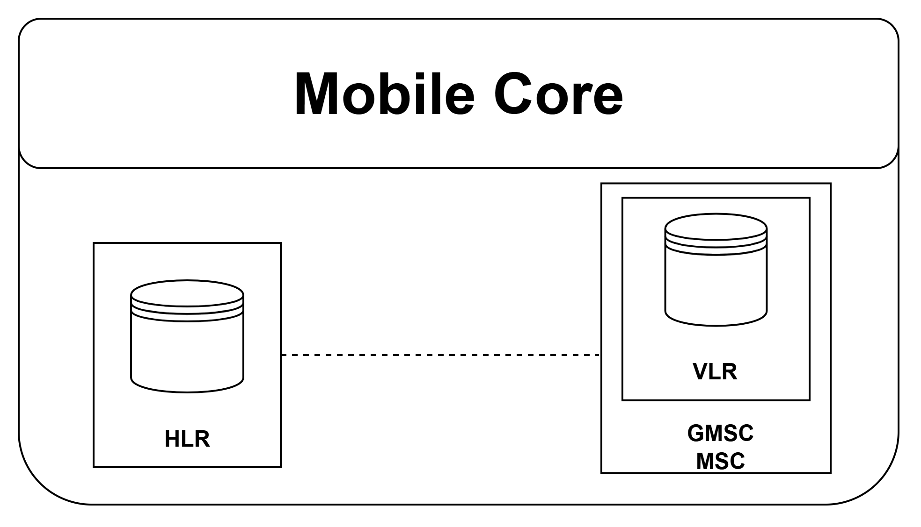
GSM Core Network (Network Switching Subsystem)
The Mobile Core Network is the intelligence of the GSM system. It is responsible for managing subscribers, establishing voice calls, providing mobility support, and connecting users to external telephone networks.
Component | Primary Function
MSC (Mobile Switching Center) | Establishes, routes, and manages voice calls within the GSM network; supports mobility management.
GMSC (Gateway Mobile Switching Center) | Acts as the gateway between the GSM network and external networks (PSTN/ISDN or other mobile networks); determines the destination MSC for incoming calls.
HLR (Home Location Register) | Stores permanent subscriber information, subscribed services, and the subscriber's current serving MSC/VLR.
VLR (Visitor Location Register) | Temporarily stores information about subscribers currently registered in an MSC service area.
AuC (Authentication Center) | Authenticates subscribers and generates security keys for encryption.
EIR (Equipment Identity Register) | Maintains the IMEI database and allows or blocks mobile devices from accessing the network.
More Users
Beer Spectrum
Higher Capacity
Better Experience
Part II
Notes:
This final slide of Part I summarizes the core objectives that have guided the evolution of cellular networks across all generations. Understanding these objectives helps us appreciate why each design decision was made and what the industry aims to achieve with ongoing research into 5G-Advanced and 6G. Let's examine the ten key parameters that cellular engineers continuously optimize: **Coverage:** From 1G to 5G, the goal has always been to extend network reach. Early cellular networks covered only major cities. Today, we expect coverage everywhere—rural areas, highways, underground trains, and even remote oceans via satellite integration. Each generation improves propagation characteristics and builds more cell towers. **Capacity:** As more users join and each user consumes more data, networks must handle higher traffic density. Techniques like cell splitting (dividing large cells into smaller ones), spectrum expansion, and advanced modulation have multiplied network capacity by millions of times since 1G. **Data Rate:** Perhaps the most visible metric—each generation delivers dramatically faster speeds. 1G's 2.4 kbps versus 5G's 20 Gbps represents an approximately 8-million-fold increase. This enables richer applications from text to video to immersive experiences. **Latency:** While early networks had latency of hundreds of milliseconds, 5G aims for under 1 millisecond. Low latency is critical for real-time applications like online gaming, virtual reality, remote surgery, and autonomous vehicle coordination where delays can be dangerous. **Reliability:** 5G targets 99.9999% reliability (six nines) for mission-critical applications. This means the network can fail for only about 30 seconds per year. Achieving this requires redundant infrastructure, intelligent routing, and self-healing network capabilities. **Security:** Each generation has introduced stronger encryption and authentication. 5G implements advanced security features including stronger encryption algorithms, subscriber privacy protection, and network slicing isolation to prevent cross-tenant attacks. **Energy Efficiency:** With billions of devices and millions of base stations, energy consumption matters both environmentally and economically. 5G is designed to use significantly less energy per bit transmitted, and supports features that allow IoT devices to operate for years on a single battery. **Quality of Service (QoS):** Modern networks must prioritize different traffic types appropriately—emergency calls get highest priority, video calls need consistent bandwidth, and IoT sensors can tolerate delays. Network slicing in 5G creates virtual networks optimized for specific services. **Mobility:** Supporting users moving at high speeds—from walking to cars to high-speed trains—is a fundamental cellular challenge. Each generation improves handover mechanisms that seamlessly transfer connections between base stations. **Spectral Efficiency:** Spectrum is limited and expensive. Each generation packs more bits per Hertz of spectrum through advanced techniques like MIMO (Multiple Input Multiple Output), beamforming, and higher-order modulation. The conceptual diagram shows the virtuous cycle: more users demand better spectrum usage, which enables higher capacity, which delivers higher speed, which creates better user experience—driving demand even further.

Slide 6
2.5G – General Packet Radio Service (GPRS)
2.5G refers to GPRS (General Packet Radio Service), an enhancement to the GSM (2G) network that introduced packet-switched data services. While GSM was primarily designed for voice communication using circuit switching, GPRS enabled users to access internet-based services such as web browsing, email, and multimedia messaging more efficiently.
What changed in GPRS?
The biggest innovation was the introduction of packet switching.
Instead of reserving a dedicated communication channel for the entire session, data is divided into small packets. These packets are transmitted only when there is actual data to send, allowing multiple users to share the same radio resources efficiently.This significantly improved bandwidth utilization.
More Users
Beer Spectrum
Higher Capacity
Higher Speed
Better Experience
Part II
Notes:
This final slide of Part I summarizes the core objectives that have guided the evolution of cellular networks across all generations. Understanding these objectives helps us appreciate why each design decision was made and what the industry aims to achieve with ongoing research into 5G-Advanced and 6G. Let's examine the ten key parameters that cellular engineers continuously optimize: **Coverage:** From 1G to 5G, the goal has always been to extend network reach. Early cellular networks covered only major cities. Today, we expect coverage everywhere—rural areas, highways, underground trains, and even remote oceans via satellite integration. Each generation improves propagation characteristics and builds more cell towers. **Capacity:** As more users join and each user consumes more data, networks must handle higher traffic density. Techniques like cell splitting (dividing large cells into smaller ones), spectrum expansion, and advanced modulation have multiplied network capacity by millions of times since 1G. **Data Rate:** Perhaps the most visible metric—each generation delivers dramatically faster speeds. 1G's 2.4 kbps versus 5G's 20 Gbps represents an approximately 8-million-fold increase. This enables richer applications from text to video to immersive experiences. **Latency:** While early networks had latency of hundreds of milliseconds, 5G aims for under 1 millisecond. Low latency is critical for real-time applications like online gaming, virtual reality, remote surgery, and autonomous vehicle coordination where delays can be dangerous. **Reliability:** 5G targets 99.9999% reliability (six nines) for mission-critical applications. This means the network can fail for only about 30 seconds per year. Achieving this requires redundant infrastructure, intelligent routing, and self-healing network capabilities. **Security:** Each generation has introduced stronger encryption and authentication. 5G implements advanced security features including stronger encryption algorithms, subscriber privacy protection, and network slicing isolation to prevent cross-tenant attacks. **Energy Efficiency:** With billions of devices and millions of base stations, energy consumption matters both environmentally and economically. 5G is designed to use significantly less energy per bit transmitted, and supports features that allow IoT devices to operate for years on a single battery. **Quality of Service (QoS):** Modern networks must prioritize different traffic types appropriately—emergency calls get highest priority, video calls need consistent bandwidth, and IoT sensors can tolerate delays. Network slicing in 5G creates virtual networks optimized for specific services. **Mobility:** Supporting users moving at high speeds—from walking to cars to high-speed trains—is a fundamental cellular challenge. Each generation improves handover mechanisms that seamlessly transfer connections between base stations. **Spectral Efficiency:** Spectrum is limited and expensive. Each generation packs more bits per Hertz of spectrum through advanced techniques like MIMO (Multiple Input Multiple Output), beamforming, and higher-order modulation. The conceptual diagram shows the virtuous cycle: more users demand better spectrum usage, which enables higher capacity, which delivers higher speed, which creates better user experience—driving demand even further.

Slide 7
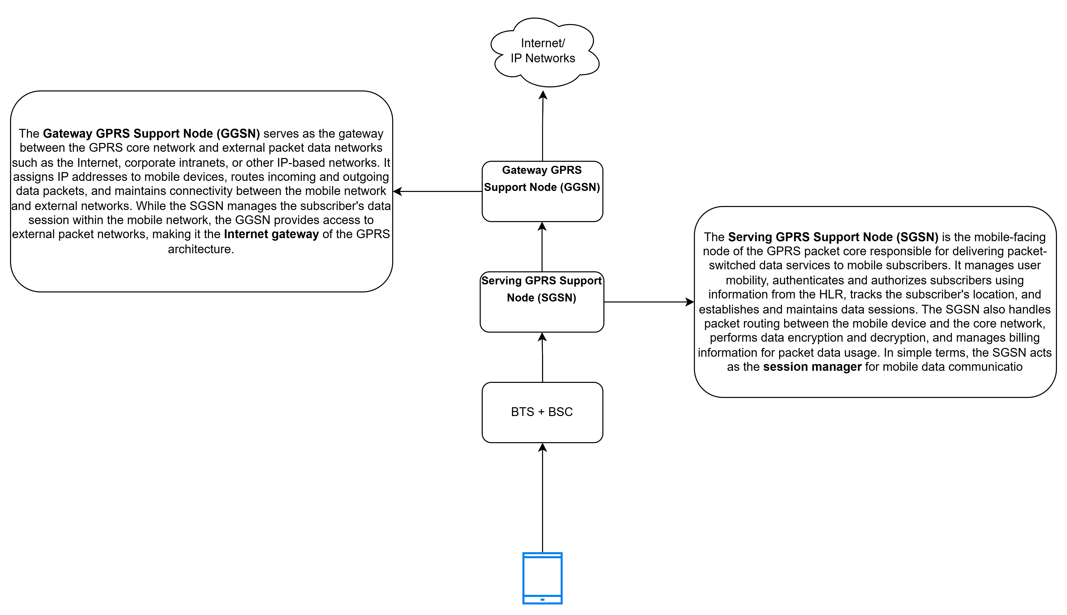
2.5G – General Packet Radio Service (GPRS)
More Users
Beer Spectrum
Higher Capacity
Higher Speed
Better Experience
Part II
Notes:
This final slide of Part I summarizes the core objectives that have guided the evolution of cellular networks across all generations. Understanding these objectives helps us appreciate why each design decision was made and what the industry aims to achieve with ongoing research into 5G-Advanced and 6G. Let's examine the ten key parameters that cellular engineers continuously optimize: **Coverage:** From 1G to 5G, the goal has always been to extend network reach. Early cellular networks covered only major cities. Today, we expect coverage everywhere—rural areas, highways, underground trains, and even remote oceans via satellite integration. Each generation improves propagation characteristics and builds more cell towers. **Capacity:** As more users join and each user consumes more data, networks must handle higher traffic density. Techniques like cell splitting (dividing large cells into smaller ones), spectrum expansion, and advanced modulation have multiplied network capacity by millions of times since 1G. **Data Rate:** Perhaps the most visible metric—each generation delivers dramatically faster speeds. 1G's 2.4 kbps versus 5G's 20 Gbps represents an approximately 8-million-fold increase. This enables richer applications from text to video to immersive experiences. **Latency:** While early networks had latency of hundreds of milliseconds, 5G aims for under 1 millisecond. Low latency is critical for real-time applications like online gaming, virtual reality, remote surgery, and autonomous vehicle coordination where delays can be dangerous. **Reliability:** 5G targets 99.9999% reliability (six nines) for mission-critical applications. This means the network can fail for only about 30 seconds per year. Achieving this requires redundant infrastructure, intelligent routing, and self-healing network capabilities. **Security:** Each generation has introduced stronger encryption and authentication. 5G implements advanced security features including stronger encryption algorithms, subscriber privacy protection, and network slicing isolation to prevent cross-tenant attacks. **Energy Efficiency:** With billions of devices and millions of base stations, energy consumption matters both environmentally and economically. 5G is designed to use significantly less energy per bit transmitted, and supports features that allow IoT devices to operate for years on a single battery. **Quality of Service (QoS):** Modern networks must prioritize different traffic types appropriately—emergency calls get highest priority, video calls need consistent bandwidth, and IoT sensors can tolerate delays. Network slicing in 5G creates virtual networks optimized for specific services. **Mobility:** Supporting users moving at high speeds—from walking to cars to high-speed trains—is a fundamental cellular challenge. Each generation improves handover mechanisms that seamlessly transfer connections between base stations. **Spectral Efficiency:** Spectrum is limited and expensive. Each generation packs more bits per Hertz of spectrum through advanced techniques like MIMO (Multiple Input Multiple Output), beamforming, and higher-order modulation. The conceptual diagram shows the virtuous cycle: more users demand better spectrum usage, which enables higher capacity, which delivers higher speed, which creates better user experience—driving demand even further.

Slide 8
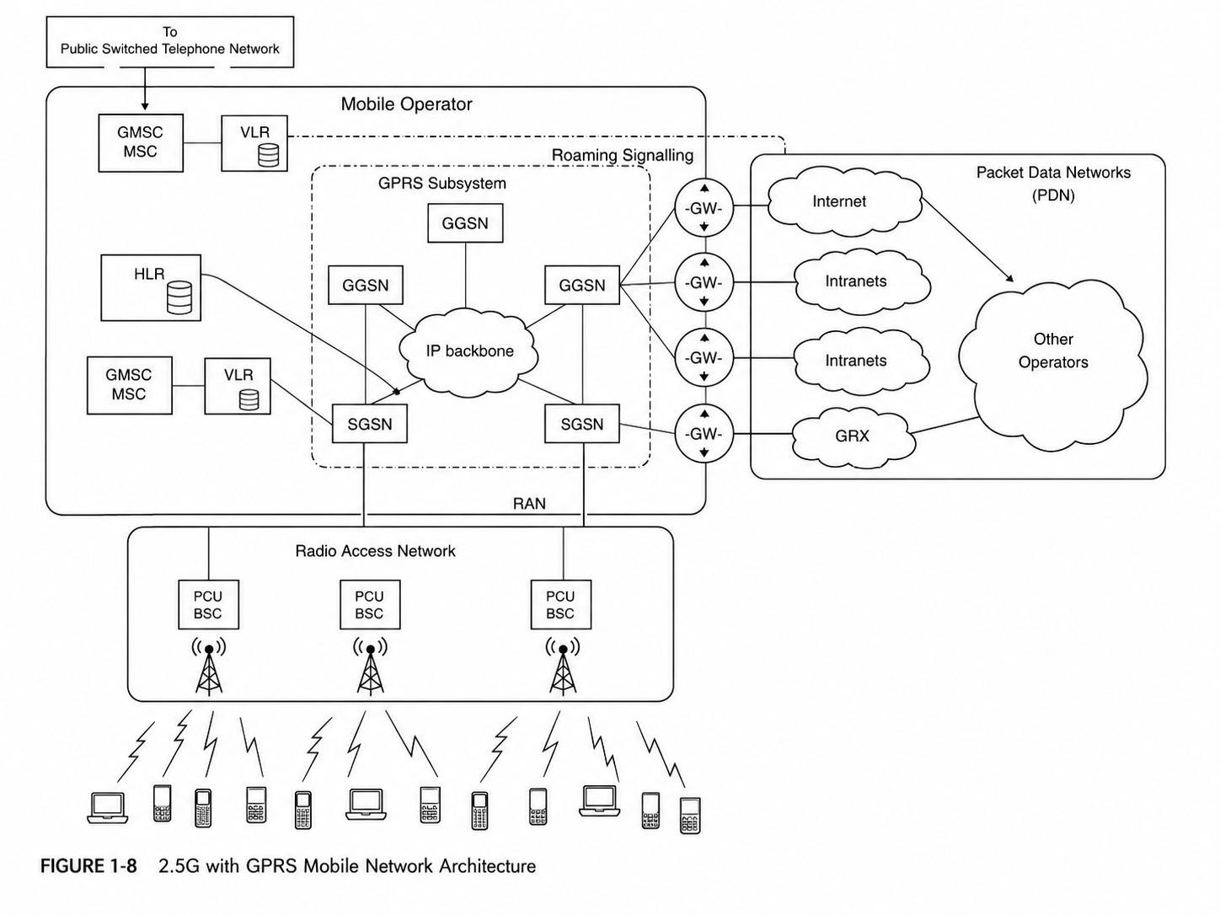
2.5G architecture with GPRS Subsystems
More Users
Beer Spectrum
Higher Capacity
Higher Speed
Better Experience
Part II
Notes:
This final slide of Part I summarizes the core objectives that have guided the evolution of cellular networks across all generations. Understanding these objectives helps us appreciate why each design decision was made and what the industry aims to achieve with ongoing research into 5G-Advanced and 6G. Let's examine the ten key parameters that cellular engineers continuously optimize: **Coverage:** From 1G to 5G, the goal has always been to extend network reach. Early cellular networks covered only major cities. Today, we expect coverage everywhere—rural areas, highways, underground trains, and even remote oceans via satellite integration. Each generation improves propagation characteristics and builds more cell towers. **Capacity:** As more users join and each user consumes more data, networks must handle higher traffic density. Techniques like cell splitting (dividing large cells into smaller ones), spectrum expansion, and advanced modulation have multiplied network capacity by millions of times since 1G. **Data Rate:** Perhaps the most visible metric—each generation delivers dramatically faster speeds. 1G's 2.4 kbps versus 5G's 20 Gbps represents an approximately 8-million-fold increase. This enables richer applications from text to video to immersive experiences. **Latency:** While early networks had latency of hundreds of milliseconds, 5G aims for under 1 millisecond. Low latency is critical for real-time applications like online gaming, virtual reality, remote surgery, and autonomous vehicle coordination where delays can be dangerous. **Reliability:** 5G targets 99.9999% reliability (six nines) for mission-critical applications. This means the network can fail for only about 30 seconds per year. Achieving this requires redundant infrastructure, intelligent routing, and self-healing network capabilities. **Security:** Each generation has introduced stronger encryption and authentication. 5G implements advanced security features including stronger encryption algorithms, subscriber privacy protection, and network slicing isolation to prevent cross-tenant attacks. **Energy Efficiency:** With billions of devices and millions of base stations, energy consumption matters both environmentally and economically. 5G is designed to use significantly less energy per bit transmitted, and supports features that allow IoT devices to operate for years on a single battery. **Quality of Service (QoS):** Modern networks must prioritize different traffic types appropriately—emergency calls get highest priority, video calls need consistent bandwidth, and IoT sensors can tolerate delays. Network slicing in 5G creates virtual networks optimized for specific services. **Mobility:** Supporting users moving at high speeds—from walking to cars to high-speed trains—is a fundamental cellular challenge. Each generation improves handover mechanisms that seamlessly transfer connections between base stations. **Spectral Efficiency:** Spectrum is limited and expensive. Each generation packs more bits per Hertz of spectrum through advanced techniques like MIMO (Multiple Input Multiple Output), beamforming, and higher-order modulation. The conceptual diagram shows the virtuous cycle: more users demand better spectrum usage, which enables higher capacity, which delivers higher speed, which creates better user experience—driving demand even further.

Slide 9
2.75G – EDGE (Enhanced Data Rates for GSM Evolution)
What is EDGE?
EDGE (Enhanced Data Rates for GSM Evolution), commonly referred to as 2.75G, was introduced as an enhancement to the existing GPRS (2.5G) network to improve packet-switched data communication.
Unlike a completely new cellular generation, EDGE reused the existing GSM radio access infrastructure while introducing more efficient modulation and coding techniques.
It served as an intermediate technology between GPRS and UMTS (3G), providing higher data rates without requiring operators to deploy an entirely new network.
Why was EDGE introduced?
The rapid growth of Internet-based services created a demand for higher mobile data rates that GPRS could not efficiently support.
Network operators required a cost-effective solution that improved performance while preserving their existing GSM infrastructure and spectrum allocations.
Key Features
Introduced 8-PSK modulation together with adaptive modulation and coding schemes to increase spectral efficiency.
Supported a maximum theoretical data rate of 384 kbps by utilizing all eight GSM time slots.
Significantly improved web browsing, multimedia messaging, email, and other packet-based services.
More Users
Higher Capacity
Higher Speed
Better Experience
Part II
Notes:
This final slide of Part I summarizes the core objectives that have guided the evolution of cellular networks across all generations. Understanding these objectives helps us appreciate why each design decision was made and what the industry aims to achieve with ongoing research into 5G-Advanced and 6G. Let's examine the ten key parameters that cellular engineers continuously optimize: **Coverage:** From 1G to 5G, the goal has always been to extend network reach. Early cellular networks covered only major cities. Today, we expect coverage everywhere—rural areas, highways, underground trains, and even remote oceans via satellite integration. Each generation improves propagation characteristics and builds more cell towers. **Capacity:** As more users join and each user consumes more data, networks must handle higher traffic density. Techniques like cell splitting (dividing large cells into smaller ones), spectrum expansion, and advanced modulation have multiplied network capacity by millions of times since 1G. **Data Rate:** Perhaps the most visible metric—each generation delivers dramatically faster speeds. 1G's 2.4 kbps versus 5G's 20 Gbps represents an approximately 8-million-fold increase. This enables richer applications from text to video to immersive experiences. **Latency:** While early networks had latency of hundreds of milliseconds, 5G aims for under 1 millisecond. Low latency is critical for real-time applications like online gaming, virtual reality, remote surgery, and autonomous vehicle coordination where delays can be dangerous. **Reliability:** 5G targets 99.9999% reliability (six nines) for mission-critical applications. This means the network can fail for only about 30 seconds per year. Achieving this requires redundant infrastructure, intelligent routing, and self-healing network capabilities. **Security:** Each generation has introduced stronger encryption and authentication. 5G implements advanced security features including stronger encryption algorithms, subscriber privacy protection, and network slicing isolation to prevent cross-tenant attacks. **Energy Efficiency:** With billions of devices and millions of base stations, energy consumption matters both environmentally and economically. 5G is designed to use significantly less energy per bit transmitted, and supports features that allow IoT devices to operate for years on a single battery. **Quality of Service (QoS):** Modern networks must prioritize different traffic types appropriately—emergency calls get highest priority, video calls need consistent bandwidth, and IoT sensors can tolerate delays. Network slicing in 5G creates virtual networks optimized for specific services. **Mobility:** Supporting users moving at high speeds—from walking to cars to high-speed trains—is a fundamental cellular challenge. Each generation improves handover mechanisms that seamlessly transfer connections between base stations. **Spectral Efficiency:** Spectrum is limited and expensive. Each generation packs more bits per Hertz of spectrum through advanced techniques like MIMO (Multiple Input Multiple Output), beamforming, and higher-order modulation. The conceptual diagram shows the virtuous cycle: more users demand better spectrum usage, which enables higher capacity, which delivers higher speed, which creates better user experience—driving demand even further.

Slide 10
Motivation for Third Generation Networks
Need for a New Generation
Although EDGE significantly improved packet data transmission, it could not satisfy the rapidly increasing demand for high-speed mobile Internet and multimedia applications.
The growing number of subscribers, combined with higher bandwidth requirements, necessitated a completely new radio access technology with improved spectral efficiency and network capacity.
The objective was not only to increase data rates but also to support a wide variety of real-time multimedia services while maintaining seamless mobility.
Emerging Applications
Video calling and real-time multimedia communication
Mobile Internet access with improved browsing experience
Audio and video streaming services
GPS-based navigation and location-aware applications
Collaborative and multimedia-rich mobile services
Additional Driving Factor
The widespread adoption of broadband Internet technologies such as DSL and Cable significantly increased user expectations, creating the need for mobile networks capable of delivering broadband-like performance.
More Users
Beer Spectrum
Higher Capacity
Higher Speed
Better Experience
Part II
Notes:
This final slide of Part I summarizes the core objectives that have guided the evolution of cellular networks across all generations. Understanding these objectives helps us appreciate why each design decision was made and what the industry aims to achieve with ongoing research into 5G-Advanced and 6G. Let's examine the ten key parameters that cellular engineers continuously optimize: **Coverage:** From 1G to 5G, the goal has always been to extend network reach. Early cellular networks covered only major cities. Today, we expect coverage everywhere—rural areas, highways, underground trains, and even remote oceans via satellite integration. Each generation improves propagation characteristics and builds more cell towers. **Capacity:** As more users join and each user consumes more data, networks must handle higher traffic density. Techniques like cell splitting (dividing large cells into smaller ones), spectrum expansion, and advanced modulation have multiplied network capacity by millions of times since 1G. **Data Rate:** Perhaps the most visible metric—each generation delivers dramatically faster speeds. 1G's 2.4 kbps versus 5G's 20 Gbps represents an approximately 8-million-fold increase. This enables richer applications from text to video to immersive experiences. **Latency:** While early networks had latency of hundreds of milliseconds, 5G aims for under 1 millisecond. Low latency is critical for real-time applications like online gaming, virtual reality, remote surgery, and autonomous vehicle coordination where delays can be dangerous. **Reliability:** 5G targets 99.9999% reliability (six nines) for mission-critical applications. This means the network can fail for only about 30 seconds per year. Achieving this requires redundant infrastructure, intelligent routing, and self-healing network capabilities. **Security:** Each generation has introduced stronger encryption and authentication. 5G implements advanced security features including stronger encryption algorithms, subscriber privacy protection, and network slicing isolation to prevent cross-tenant attacks. **Energy Efficiency:** With billions of devices and millions of base stations, energy consumption matters both environmentally and economically. 5G is designed to use significantly less energy per bit transmitted, and supports features that allow IoT devices to operate for years on a single battery. **Quality of Service (QoS):** Modern networks must prioritize different traffic types appropriately—emergency calls get highest priority, video calls need consistent bandwidth, and IoT sensors can tolerate delays. Network slicing in 5G creates virtual networks optimized for specific services. **Mobility:** Supporting users moving at high speeds—from walking to cars to high-speed trains—is a fundamental cellular challenge. Each generation improves handover mechanisms that seamlessly transfer connections between base stations. **Spectral Efficiency:** Spectrum is limited and expensive. Each generation packs more bits per Hertz of spectrum through advanced techniques like MIMO (Multiple Input Multiple Output), beamforming, and higher-order modulation. The conceptual diagram shows the virtuous cycle: more users demand better spectrum usage, which enables higher capacity, which delivers higher speed, which creates better user experience—driving demand even further.

Slide 11
3GPP Standardization
What is 3GPP?
The 3rd Generation Partnership Project (3GPP) formed in 1998, is an international standards organization responsible for developing global specifications for modern mobile communication systems. Since its establishment, 3GPP has standardized 3G (UMTS), 4G LTE, LTE-Advanced, 5G NR, and continues to develop standards for 5G-Advanced and future 6G technologies.
Technical Specification Groups (TSGs)
3GPP develops standards through three major Technical Specification Groups:
RAN (Radio Access Network): Develops radio interface technologies and access network protocols.
SA (Services and System Aspects): Defines overall system architecture, security, network slicing, and service capabilities.
CT (Core Network and Terminals): Develops protocols related to the core network and user equipment.
Each TSG consists of multiple Working Groups responsible for different aspects of mobile communication standardization
More Users
Beer Spectrum
Higher Capacity
Higher Speed
Better Experience
Part II
Notes:
This final slide of Part I summarizes the core objectives that have guided the evolution of cellular networks across all generations. Understanding these objectives helps us appreciate why each design decision was made and what the industry aims to achieve with ongoing research into 5G-Advanced and 6G. Let's examine the ten key parameters that cellular engineers continuously optimize: **Coverage:** From 1G to 5G, the goal has always been to extend network reach. Early cellular networks covered only major cities. Today, we expect coverage everywhere—rural areas, highways, underground trains, and even remote oceans via satellite integration. Each generation improves propagation characteristics and builds more cell towers. **Capacity:** As more users join and each user consumes more data, networks must handle higher traffic density. Techniques like cell splitting (dividing large cells into smaller ones), spectrum expansion, and advanced modulation have multiplied network capacity by millions of times since 1G. **Data Rate:** Perhaps the most visible metric—each generation delivers dramatically faster speeds. 1G's 2.4 kbps versus 5G's 20 Gbps represents an approximately 8-million-fold increase. This enables richer applications from text to video to immersive experiences. **Latency:** While early networks had latency of hundreds of milliseconds, 5G aims for under 1 millisecond. Low latency is critical for real-time applications like online gaming, virtual reality, remote surgery, and autonomous vehicle coordination where delays can be dangerous. **Reliability:** 5G targets 99.9999% reliability (six nines) for mission-critical applications. This means the network can fail for only about 30 seconds per year. Achieving this requires redundant infrastructure, intelligent routing, and self-healing network capabilities. **Security:** Each generation has introduced stronger encryption and authentication. 5G implements advanced security features including stronger encryption algorithms, subscriber privacy protection, and network slicing isolation to prevent cross-tenant attacks. **Energy Efficiency:** With billions of devices and millions of base stations, energy consumption matters both environmentally and economically. 5G is designed to use significantly less energy per bit transmitted, and supports features that allow IoT devices to operate for years on a single battery. **Quality of Service (QoS):** Modern networks must prioritize different traffic types appropriately—emergency calls get highest priority, video calls need consistent bandwidth, and IoT sensors can tolerate delays. Network slicing in 5G creates virtual networks optimized for specific services. **Mobility:** Supporting users moving at high speeds—from walking to cars to high-speed trains—is a fundamental cellular challenge. Each generation improves handover mechanisms that seamlessly transfer connections between base stations. **Spectral Efficiency:** Spectrum is limited and expensive. Each generation packs more bits per Hertz of spectrum through advanced techniques like MIMO (Multiple Input Multiple Output), beamforming, and higher-order modulation. The conceptual diagram shows the virtuous cycle: more users demand better spectrum usage, which enables higher capacity, which delivers higher speed, which creates better user experience—driving demand even further.

Slide 12
3G/UMTS Architecture
UMTS Network Architecture
The Universal Mobile Telecommunications System (UMTS) architecture is divided into two major subsystems:
1. UTRAN (UMTS Terrestrial Radio Access Network)
Provides the wireless interface between the User Equipment (UE) and the Core Network using the WCDMA radio access technology.
Major Components
Node B – UMTS base station responsible for radio transmission, reception, and WCDMA signal processing.
Radio Network Controller (RNC) – Controls multiple Node Bs, performs radio resource management, admission control, mobility management, and soft handovers.
2. Core Network (CN)
Provides switching, mobility management, authentication, Internet connectivity, and interconnection with external communication networks.
Circuit-Switched Domain
MSC Server – Call control and mobility management.
Media Gateway (MGW) – Voice traffic transport.
GMSC – Gateway to external telephone networks (PSTN/ISDN).
Packet-Switched Domain
SGSN – Packet mobility management and session control.
GGSN – Gateway connecting UMTS users to external IP networks such as the Internet.
More Users
Beer Spectrum
Higher Capacity
Higher Speed
Better Experience
Part II
Notes:
This final slide of Part I summarizes the core objectives that have guided the evolution of cellular networks across all generations. Understanding these objectives helps us appreciate why each design decision was made and what the industry aims to achieve with ongoing research into 5G-Advanced and 6G. Let's examine the ten key parameters that cellular engineers continuously optimize: **Coverage:** From 1G to 5G, the goal has always been to extend network reach. Early cellular networks covered only major cities. Today, we expect coverage everywhere—rural areas, highways, underground trains, and even remote oceans via satellite integration. Each generation improves propagation characteristics and builds more cell towers. **Capacity:** As more users join and each user consumes more data, networks must handle higher traffic density. Techniques like cell splitting (dividing large cells into smaller ones), spectrum expansion, and advanced modulation have multiplied network capacity by millions of times since 1G. **Data Rate:** Perhaps the most visible metric—each generation delivers dramatically faster speeds. 1G's 2.4 kbps versus 5G's 20 Gbps represents an approximately 8-million-fold increase. This enables richer applications from text to video to immersive experiences. **Latency:** While early networks had latency of hundreds of milliseconds, 5G aims for under 1 millisecond. Low latency is critical for real-time applications like online gaming, virtual reality, remote surgery, and autonomous vehicle coordination where delays can be dangerous. **Reliability:** 5G targets 99.9999% reliability (six nines) for mission-critical applications. This means the network can fail for only about 30 seconds per year. Achieving this requires redundant infrastructure, intelligent routing, and self-healing network capabilities. **Security:** Each generation has introduced stronger encryption and authentication. 5G implements advanced security features including stronger encryption algorithms, subscriber privacy protection, and network slicing isolation to prevent cross-tenant attacks. **Energy Efficiency:** With billions of devices and millions of base stations, energy consumption matters both environmentally and economically. 5G is designed to use significantly less energy per bit transmitted, and supports features that allow IoT devices to operate for years on a single battery. **Quality of Service (QoS):** Modern networks must prioritize different traffic types appropriately—emergency calls get highest priority, video calls need consistent bandwidth, and IoT sensors can tolerate delays. Network slicing in 5G creates virtual networks optimized for specific services. **Mobility:** Supporting users moving at high speeds—from walking to cars to high-speed trains—is a fundamental cellular challenge. Each generation improves handover mechanisms that seamlessly transfer connections between base stations. **Spectral Efficiency:** Spectrum is limited and expensive. Each generation packs more bits per Hertz of spectrum through advanced techniques like MIMO (Multiple Input Multiple Output), beamforming, and higher-order modulation. The conceptual diagram shows the virtuous cycle: more users demand better spectrum usage, which enables higher capacity, which delivers higher speed, which creates better user experience—driving demand even further.

Slide 13
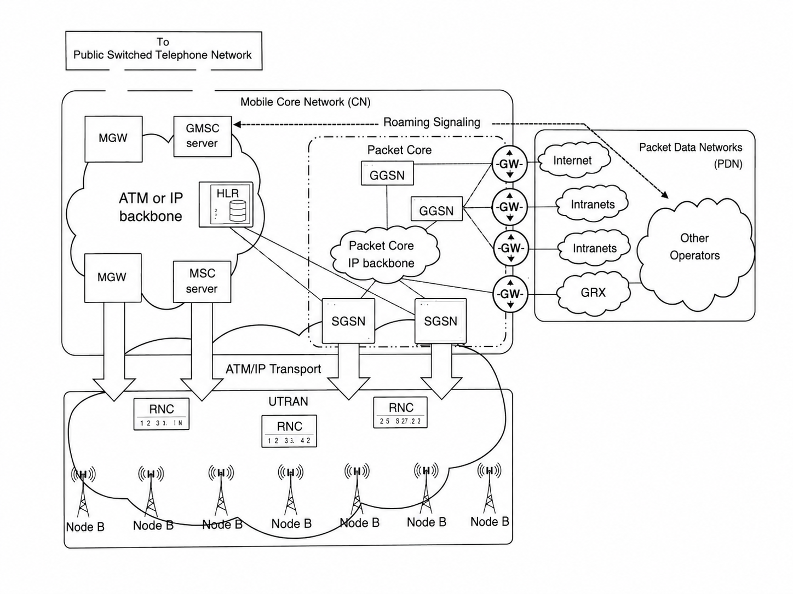
3G / UMTS Architecture
More Users
Beer Spectrum
Higher Capacity
Higher Speed
Better Experience
Part II
Notes:
This final slide of Part I summarizes the core objectives that have guided the evolution of cellular networks across all generations. Understanding these objectives helps us appreciate why each design decision was made and what the industry aims to achieve with ongoing research into 5G-Advanced and 6G. Let's examine the ten key parameters that cellular engineers continuously optimize: **Coverage:** From 1G to 5G, the goal has always been to extend network reach. Early cellular networks covered only major cities. Today, we expect coverage everywhere—rural areas, highways, underground trains, and even remote oceans via satellite integration. Each generation improves propagation characteristics and builds more cell towers. **Capacity:** As more users join and each user consumes more data, networks must handle higher traffic density. Techniques like cell splitting (dividing large cells into smaller ones), spectrum expansion, and advanced modulation have multiplied network capacity by millions of times since 1G. **Data Rate:** Perhaps the most visible metric—each generation delivers dramatically faster speeds. 1G's 2.4 kbps versus 5G's 20 Gbps represents an approximately 8-million-fold increase. This enables richer applications from text to video to immersive experiences. **Latency:** While early networks had latency of hundreds of milliseconds, 5G aims for under 1 millisecond. Low latency is critical for real-time applications like online gaming, virtual reality, remote surgery, and autonomous vehicle coordination where delays can be dangerous. **Reliability:** 5G targets 99.9999% reliability (six nines) for mission-critical applications. This means the network can fail for only about 30 seconds per year. Achieving this requires redundant infrastructure, intelligent routing, and self-healing network capabilities. **Security:** Each generation has introduced stronger encryption and authentication. 5G implements advanced security features including stronger encryption algorithms, subscriber privacy protection, and network slicing isolation to prevent cross-tenant attacks. **Energy Efficiency:** With billions of devices and millions of base stations, energy consumption matters both environmentally and economically. 5G is designed to use significantly less energy per bit transmitted, and supports features that allow IoT devices to operate for years on a single battery. **Quality of Service (QoS):** Modern networks must prioritize different traffic types appropriately—emergency calls get highest priority, video calls need consistent bandwidth, and IoT sensors can tolerate delays. Network slicing in 5G creates virtual networks optimized for specific services. **Mobility:** Supporting users moving at high speeds—from walking to cars to high-speed trains—is a fundamental cellular challenge. Each generation improves handover mechanisms that seamlessly transfer connections between base stations. **Spectral Efficiency:** Spectrum is limited and expensive. Each generation packs more bits per Hertz of spectrum through advanced techniques like MIMO (Multiple Input Multiple Output), beamforming, and higher-order modulation. The conceptual diagram shows the virtuous cycle: more users demand better spectrum usage, which enables higher capacity, which delivers higher speed, which creates better user experience—driving demand even further.

Slide 14
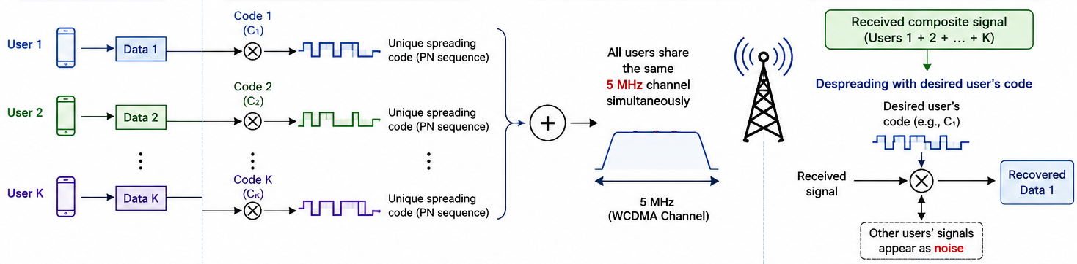
Innovations in 3G Radio Access
The most significant technological advancement introduced by UMTS was the replacement of TDMA with Wideband Code Division Multiple Access (WCDMA) as the primary radio access technology.
Advantages of WCDMA
Utilizes a 5 MHz wide radio channel, considerably larger than GSM.
Allows multiple users to transmit simultaneously on the same frequency using unique spreading codes.
Provides higher system capacity, improved spectral efficiency, better interference management, and significantly higher data rates.
WCDMA Principle
Unlike TDMA or FDMA, WCDMA allows multiple users to share the same frequency channel simultaneously.
Each user's information is multiplied by a unique spreading code before transmission, spreading the signal over a wider bandwidth. At the receiver, the same spreading code is used to recover the intended signal while treating signals from other users as background interference. This technique improves spectrum utilization while supporting a large number of simultaneous users.
More Users
Beer Spectrum
Higher Capacity
Better Experience
Part II
Notes:
This final slide of Part I summarizes the core objectives that have guided the evolution of cellular networks across all generations. Understanding these objectives helps us appreciate why each design decision was made and what the industry aims to achieve with ongoing research into 5G-Advanced and 6G. Let's examine the ten key parameters that cellular engineers continuously optimize: **Coverage:** From 1G to 5G, the goal has always been to extend network reach. Early cellular networks covered only major cities. Today, we expect coverage everywhere—rural areas, highways, underground trains, and even remote oceans via satellite integration. Each generation improves propagation characteristics and builds more cell towers. **Capacity:** As more users join and each user consumes more data, networks must handle higher traffic density. Techniques like cell splitting (dividing large cells into smaller ones), spectrum expansion, and advanced modulation have multiplied network capacity by millions of times since 1G. **Data Rate:** Perhaps the most visible metric—each generation delivers dramatically faster speeds. 1G's 2.4 kbps versus 5G's 20 Gbps represents an approximately 8-million-fold increase. This enables richer applications from text to video to immersive experiences. **Latency:** While early networks had latency of hundreds of milliseconds, 5G aims for under 1 millisecond. Low latency is critical for real-time applications like online gaming, virtual reality, remote surgery, and autonomous vehicle coordination where delays can be dangerous. **Reliability:** 5G targets 99.9999% reliability (six nines) for mission-critical applications. This means the network can fail for only about 30 seconds per year. Achieving this requires redundant infrastructure, intelligent routing, and self-healing network capabilities. **Security:** Each generation has introduced stronger encryption and authentication. 5G implements advanced security features including stronger encryption algorithms, subscriber privacy protection, and network slicing isolation to prevent cross-tenant attacks. **Energy Efficiency:** With billions of devices and millions of base stations, energy consumption matters both environmentally and economically. 5G is designed to use significantly less energy per bit transmitted, and supports features that allow IoT devices to operate for years on a single battery. **Quality of Service (QoS):** Modern networks must prioritize different traffic types appropriately—emergency calls get highest priority, video calls need consistent bandwidth, and IoT sensors can tolerate delays. Network slicing in 5G creates virtual networks optimized for specific services. **Mobility:** Supporting users moving at high speeds—from walking to cars to high-speed trains—is a fundamental cellular challenge. Each generation improves handover mechanisms that seamlessly transfer connections between base stations. **Spectral Efficiency:** Spectrum is limited and expensive. Each generation packs more bits per Hertz of spectrum through advanced techniques like MIMO (Multiple Input Multiple Output), beamforming, and higher-order modulation. The conceptual diagram shows the virtuous cycle: more users demand better spectrum usage, which enables higher capacity, which delivers higher speed, which creates better user experience—driving demand even further.

Slide 15
Additional 3G Innovations
RAKE Receiver
Combines multiple delayed signal components caused by multipath propagation to improve signal quality and reliability. Provides diversity gain, resulting in better reception under fading channel conditions.
Soft Handover
Allows a mobile device to remain connected to multiple Node Bs simultaneously during cell transitions. Reduces call drops and provides smoother mobility compared to the hard handover used in GSM.
Fast Power Control
Continuously adjusts the transmit power of both the mobile device and Node B. Effectively mitigates the Near-Far Problem, ensuring that all users arrive at the receiver with approximately equal received power.
More Users
Beer Spectrum
Higher Capacity
Higher Speed
Better Experience
Part II
Notes:
This final slide of Part I summarizes the core objectives that have guided the evolution of cellular networks across all generations. Understanding these objectives helps us appreciate why each design decision was made and what the industry aims to achieve with ongoing research into 5G-Advanced and 6G. Let's examine the ten key parameters that cellular engineers continuously optimize: **Coverage:** From 1G to 5G, the goal has always been to extend network reach. Early cellular networks covered only major cities. Today, we expect coverage everywhere—rural areas, highways, underground trains, and even remote oceans via satellite integration. Each generation improves propagation characteristics and builds more cell towers. **Capacity:** As more users join and each user consumes more data, networks must handle higher traffic density. Techniques like cell splitting (dividing large cells into smaller ones), spectrum expansion, and advanced modulation have multiplied network capacity by millions of times since 1G. **Data Rate:** Perhaps the most visible metric—each generation delivers dramatically faster speeds. 1G's 2.4 kbps versus 5G's 20 Gbps represents an approximately 8-million-fold increase. This enables richer applications from text to video to immersive experiences. **Latency:** While early networks had latency of hundreds of milliseconds, 5G aims for under 1 millisecond. Low latency is critical for real-time applications like online gaming, virtual reality, remote surgery, and autonomous vehicle coordination where delays can be dangerous. **Reliability:** 5G targets 99.9999% reliability (six nines) for mission-critical applications. This means the network can fail for only about 30 seconds per year. Achieving this requires redundant infrastructure, intelligent routing, and self-healing network capabilities. **Security:** Each generation has introduced stronger encryption and authentication. 5G implements advanced security features including stronger encryption algorithms, subscriber privacy protection, and network slicing isolation to prevent cross-tenant attacks. **Energy Efficiency:** With billions of devices and millions of base stations, energy consumption matters both environmentally and economically. 5G is designed to use significantly less energy per bit transmitted, and supports features that allow IoT devices to operate for years on a single battery. **Quality of Service (QoS):** Modern networks must prioritize different traffic types appropriately—emergency calls get highest priority, video calls need consistent bandwidth, and IoT sensors can tolerate delays. Network slicing in 5G creates virtual networks optimized for specific services. **Mobility:** Supporting users moving at high speeds—from walking to cars to high-speed trains—is a fundamental cellular challenge. Each generation improves handover mechanisms that seamlessly transfer connections between base stations. **Spectral Efficiency:** Spectrum is limited and expensive. Each generation packs more bits per Hertz of spectrum through advanced techniques like MIMO (Multiple Input Multiple Output), beamforming, and higher-order modulation. The conceptual diagram shows the virtuous cycle: more users demand better spectrum usage, which enables higher capacity, which delivers higher speed, which creates better user experience—driving demand even further.

Slide 16
3G Enhancements
Release 99 (2000) – Introduction of UMTS
Release 99 (R99) marked the first official 3GPP specification for UMTS (Universal Mobile Telecommunications System). It introduced the WCDMA radio interface, enabling data rates of up to 2 Mbps, and established the UTRAN architecture consisting of Node B and the Radio Network Controller (RNC) while retaining much of the GSM/GPRS core network.
Release 4 (2001) – Core Network Evolution
Release 4 focused on improving the core network by separating call control from media transport through the introduction of the MSC Server and Media Gateway (MGW) architecture. This distributed architecture improved network scalability, supported IP-based transport, and reduced deployment costs for mobile operators.
Release 5 (2002) – Introduction of HSDPA
Release 5 introduced High-Speed Downlink Packet Access (HSDPA), significantly increasing downlink data rates to a theoretical maximum of 14.4 Mbps. It also introduced the IP Multimedia Subsystem (IMS), enabling IP-based multimedia services such as video calling, multimedia messaging, and Voice over IP (VoIP).
More Users
Beer Spectrum
Higher Capacity
Higher Speed
Better Experience
Part II
Notes:
This final slide of Part I summarizes the core objectives that have guided the evolution of cellular networks across all generations. Understanding these objectives helps us appreciate why each design decision was made and what the industry aims to achieve with ongoing research into 5G-Advanced and 6G. Let's examine the ten key parameters that cellular engineers continuously optimize: **Coverage:** From 1G to 5G, the goal has always been to extend network reach. Early cellular networks covered only major cities. Today, we expect coverage everywhere—rural areas, highways, underground trains, and even remote oceans via satellite integration. Each generation improves propagation characteristics and builds more cell towers. **Capacity:** As more users join and each user consumes more data, networks must handle higher traffic density. Techniques like cell splitting (dividing large cells into smaller ones), spectrum expansion, and advanced modulation have multiplied network capacity by millions of times since 1G. **Data Rate:** Perhaps the most visible metric—each generation delivers dramatically faster speeds. 1G's 2.4 kbps versus 5G's 20 Gbps represents an approximately 8-million-fold increase. This enables richer applications from text to video to immersive experiences. **Latency:** While early networks had latency of hundreds of milliseconds, 5G aims for under 1 millisecond. Low latency is critical for real-time applications like online gaming, virtual reality, remote surgery, and autonomous vehicle coordination where delays can be dangerous. **Reliability:** 5G targets 99.9999% reliability (six nines) for mission-critical applications. This means the network can fail for only about 30 seconds per year. Achieving this requires redundant infrastructure, intelligent routing, and self-healing network capabilities. **Security:** Each generation has introduced stronger encryption and authentication. 5G implements advanced security features including stronger encryption algorithms, subscriber privacy protection, and network slicing isolation to prevent cross-tenant attacks. **Energy Efficiency:** With billions of devices and millions of base stations, energy consumption matters both environmentally and economically. 5G is designed to use significantly less energy per bit transmitted, and supports features that allow IoT devices to operate for years on a single battery. **Quality of Service (QoS):** Modern networks must prioritize different traffic types appropriately—emergency calls get highest priority, video calls need consistent bandwidth, and IoT sensors can tolerate delays. Network slicing in 5G creates virtual networks optimized for specific services. **Mobility:** Supporting users moving at high speeds—from walking to cars to high-speed trains—is a fundamental cellular challenge. Each generation improves handover mechanisms that seamlessly transfer connections between base stations. **Spectral Efficiency:** Spectrum is limited and expensive. Each generation packs more bits per Hertz of spectrum through advanced techniques like MIMO (Multiple Input Multiple Output), beamforming, and higher-order modulation. The conceptual diagram shows the virtuous cycle: more users demand better spectrum usage, which enables higher capacity, which delivers higher speed, which creates better user experience—driving demand even further.

Slide 17
3G Enhancements
Release 6 (2005) – Introduction of HSUPA
Release 6 enhanced the uplink by introducing High-Speed Uplink Packet Access (HSUPA), increasing theoretical uplink speeds to 5.76 Mbps while reducing transmission latency. These improvements provided better support for interactive applications such as video conferencing, online gaming, and real-time multimedia communication.
Release 7 (2007) – HSPA Evolution (HSPA+)
Release 7 introduced HSPA+ (Evolved HSPA), improving spectral efficiency through technologies such as 64-QAM modulation, MIMO, and enhanced scheduling algorithms. These enhancements increased theoretical downlink speeds to 28 Mbps while improving network capacity and overall user experience.
Release 8 (2008) – Advanced HSPA+ and LTE
Release 8 further enhanced HSPA+ by introducing Dual-Carrier HSDPA (DC-HSDPA), increasing theoretical downlink speeds to 42 Mbps and reducing network latency. More importantly, Release 8 introduced the first specifications for Long Term Evolution (LTE), marking the beginning of the transition from 3G to 4G mobile communication
More Users
Beer Spectrum
Higher Capacity
Higher Speed
Better Experience
Part II
Notes:
This final slide of Part I summarizes the core objectives that have guided the evolution of cellular networks across all generations. Understanding these objectives helps us appreciate why each design decision was made and what the industry aims to achieve with ongoing research into 5G-Advanced and 6G. Let's examine the ten key parameters that cellular engineers continuously optimize: **Coverage:** From 1G to 5G, the goal has always been to extend network reach. Early cellular networks covered only major cities. Today, we expect coverage everywhere—rural areas, highways, underground trains, and even remote oceans via satellite integration. Each generation improves propagation characteristics and builds more cell towers. **Capacity:** As more users join and each user consumes more data, networks must handle higher traffic density. Techniques like cell splitting (dividing large cells into smaller ones), spectrum expansion, and advanced modulation have multiplied network capacity by millions of times since 1G. **Data Rate:** Perhaps the most visible metric—each generation delivers dramatically faster speeds. 1G's 2.4 kbps versus 5G's 20 Gbps represents an approximately 8-million-fold increase. This enables richer applications from text to video to immersive experiences. **Latency:** While early networks had latency of hundreds of milliseconds, 5G aims for under 1 millisecond. Low latency is critical for real-time applications like online gaming, virtual reality, remote surgery, and autonomous vehicle coordination where delays can be dangerous. **Reliability:** 5G targets 99.9999% reliability (six nines) for mission-critical applications. This means the network can fail for only about 30 seconds per year. Achieving this requires redundant infrastructure, intelligent routing, and self-healing network capabilities. **Security:** Each generation has introduced stronger encryption and authentication. 5G implements advanced security features including stronger encryption algorithms, subscriber privacy protection, and network slicing isolation to prevent cross-tenant attacks. **Energy Efficiency:** With billions of devices and millions of base stations, energy consumption matters both environmentally and economically. 5G is designed to use significantly less energy per bit transmitted, and supports features that allow IoT devices to operate for years on a single battery. **Quality of Service (QoS):** Modern networks must prioritize different traffic types appropriately—emergency calls get highest priority, video calls need consistent bandwidth, and IoT sensors can tolerate delays. Network slicing in 5G creates virtual networks optimized for specific services. **Mobility:** Supporting users moving at high speeds—from walking to cars to high-speed trains—is a fundamental cellular challenge. Each generation improves handover mechanisms that seamlessly transfer connections between base stations. **Spectral Efficiency:** Spectrum is limited and expensive. Each generation packs more bits per Hertz of spectrum through advanced techniques like MIMO (Multiple Input Multiple Output), beamforming, and higher-order modulation. The conceptual diagram shows the virtuous cycle: more users demand better spectrum usage, which enables higher capacity, which delivers higher speed, which creates better user experience—driving demand even further.

Slide 18
Comparison of 2G, 2.5G, 2.75G, and 3G Networks
Feature | 2G | GPRS | EDGE | UMTS
Switching | Circuit | Packet | Packet | Circuit + Packet
Radio Access | TDMA | TDMA | TDMA + 8PSK | WCDMA
Peak Data Rate | 9.6 kbps | 171 kbps | 384 kbps | 2 Mbps
Major Innovation | Digital Voice | Internet | Faster Internet | Multimedia
More Users
Beer Spectrum
Higher Capacity
Higher Speed
Better Experience
Part II
Notes:
This final slide of Part I summarizes the core objectives that have guided the evolution of cellular networks across all generations. Understanding these objectives helps us appreciate why each design decision was made and what the industry aims to achieve with ongoing research into 5G-Advanced and 6G. Let's examine the ten key parameters that cellular engineers continuously optimize: **Coverage:** From 1G to 5G, the goal has always been to extend network reach. Early cellular networks covered only major cities. Today, we expect coverage everywhere—rural areas, highways, underground trains, and even remote oceans via satellite integration. Each generation improves propagation characteristics and builds more cell towers. **Capacity:** As more users join and each user consumes more data, networks must handle higher traffic density. Techniques like cell splitting (dividing large cells into smaller ones), spectrum expansion, and advanced modulation have multiplied network capacity by millions of times since 1G. **Data Rate:** Perhaps the most visible metric—each generation delivers dramatically faster speeds. 1G's 2.4 kbps versus 5G's 20 Gbps represents an approximately 8-million-fold increase. This enables richer applications from text to video to immersive experiences. **Latency:** While early networks had latency of hundreds of milliseconds, 5G aims for under 1 millisecond. Low latency is critical for real-time applications like online gaming, virtual reality, remote surgery, and autonomous vehicle coordination where delays can be dangerous. **Reliability:** 5G targets 99.9999% reliability (six nines) for mission-critical applications. This means the network can fail for only about 30 seconds per year. Achieving this requires redundant infrastructure, intelligent routing, and self-healing network capabilities. **Security:** Each generation has introduced stronger encryption and authentication. 5G implements advanced security features including stronger encryption algorithms, subscriber privacy protection, and network slicing isolation to prevent cross-tenant attacks. **Energy Efficiency:** With billions of devices and millions of base stations, energy consumption matters both environmentally and economically. 5G is designed to use significantly less energy per bit transmitted, and supports features that allow IoT devices to operate for years on a single battery. **Quality of Service (QoS):** Modern networks must prioritize different traffic types appropriately—emergency calls get highest priority, video calls need consistent bandwidth, and IoT sensors can tolerate delays. Network slicing in 5G creates virtual networks optimized for specific services. **Mobility:** Supporting users moving at high speeds—from walking to cars to high-speed trains—is a fundamental cellular challenge. Each generation improves handover mechanisms that seamlessly transfer connections between base stations. **Spectral Efficiency:** Spectrum is limited and expensive. Each generation packs more bits per Hertz of spectrum through advanced techniques like MIMO (Multiple Input Multiple Output), beamforming, and higher-order modulation. The conceptual diagram shows the virtuous cycle: more users demand better spectrum usage, which enables higher capacity, which delivers higher speed, which creates better user experience—driving demand even further.

Slide 19
Thank You…
Any Questions?
More Users
Beer Spectrum
Higher Capacity
Higher Speed
Better Experience
Part II
Notes:
This final slide of Part I summarizes the core objectives that have guided the evolution of cellular networks across all generations. Understanding these objectives helps us appreciate why each design decision was made and what the industry aims to achieve with ongoing research into 5G-Advanced and 6G. Let's examine the ten key parameters that cellular engineers continuously optimize: **Coverage:** From 1G to 5G, the goal has always been to extend network reach. Early cellular networks covered only major cities. Today, we expect coverage everywhere—rural areas, highways, underground trains, and even remote oceans via satellite integration. Each generation improves propagation characteristics and builds more cell towers. **Capacity:** As more users join and each user consumes more data, networks must handle higher traffic density. Techniques like cell splitting (dividing large cells into smaller ones), spectrum expansion, and advanced modulation have multiplied network capacity by millions of times since 1G. **Data Rate:** Perhaps the most visible metric—each generation delivers dramatically faster speeds. 1G's 2.4 kbps versus 5G's 20 Gbps represents an approximately 8-million-fold increase. This enables richer applications from text to video to immersive experiences. **Latency:** While early networks had latency of hundreds of milliseconds, 5G aims for under 1 millisecond. Low latency is critical for real-time applications like online gaming, virtual reality, remote surgery, and autonomous vehicle coordination where delays can be dangerous. **Reliability:** 5G targets 99.9999% reliability (six nines) for mission-critical applications. This means the network can fail for only about 30 seconds per year. Achieving this requires redundant infrastructure, intelligent routing, and self-healing network capabilities. **Security:** Each generation has introduced stronger encryption and authentication. 5G implements advanced security features including stronger encryption algorithms, subscriber privacy protection, and network slicing isolation to prevent cross-tenant attacks. **Energy Efficiency:** With billions of devices and millions of base stations, energy consumption matters both environmentally and economically. 5G is designed to use significantly less energy per bit transmitted, and supports features that allow IoT devices to operate for years on a single battery. **Quality of Service (QoS):** Modern networks must prioritize different traffic types appropriately—emergency calls get highest priority, video calls need consistent bandwidth, and IoT sensors can tolerate delays. Network slicing in 5G creates virtual networks optimized for specific services. **Mobility:** Supporting users moving at high speeds—from walking to cars to high-speed trains—is a fundamental cellular challenge. Each generation improves handover mechanisms that seamlessly transfer connections between base stations. **Spectral Efficiency:** Spectrum is limited and expensive. Each generation packs more bits per Hertz of spectrum through advanced techniques like MIMO (Multiple Input Multiple Output), beamforming, and higher-order modulation. The conceptual diagram shows the virtuous cycle: more users demand better spectrum usage, which enables higher capacity, which delivers higher speed, which creates better user experience—driving demand even further.

